Slide 1
Top Tagging Jets with Machine Learning algorithms
By: Trevor Hoyte
Supervisor: Dr Thomas Gregoire

Slide 2
Outline
Theory
What is a top quark
LHC coordinates and kinematics
Whats a Jet?
Top jets
Machine Learning
Apparatus
Procedure
Jet preprocessing
Vector transormations
Results
Accuracy
Processing results
Discussion
Results from other stuidies
Activation functions
Order of constituents

Slide 3
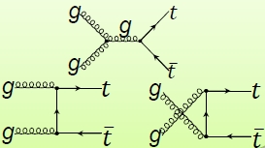
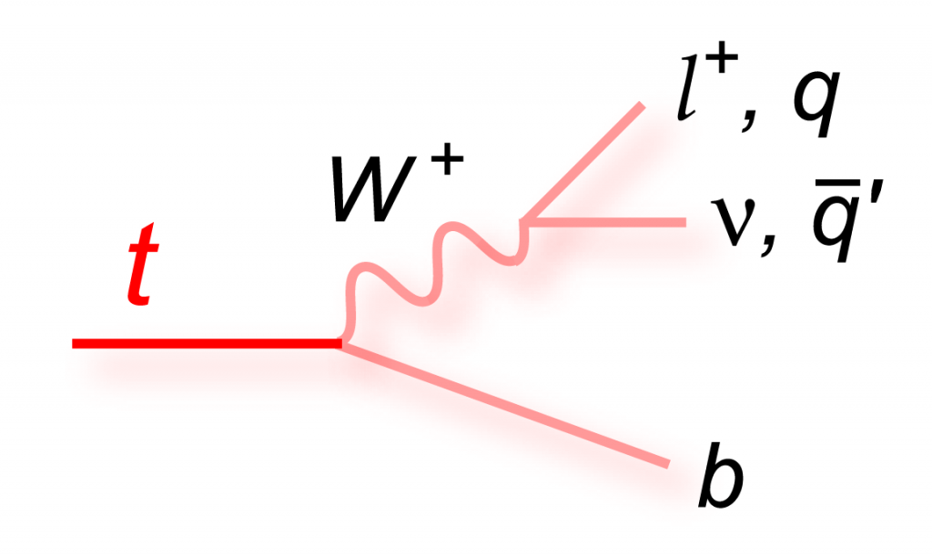
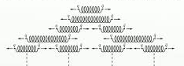
The TOP quark pair
90% of top anti top produced at LHC is the result of gluon fusion
Top three-pronged decay chain
Hadronization

Slide 4
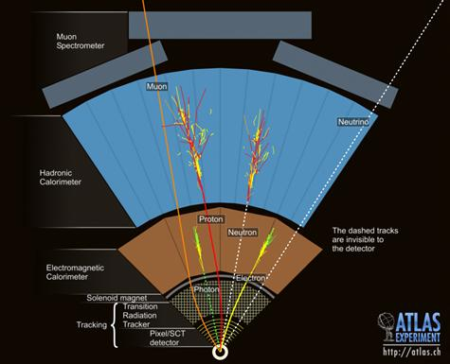
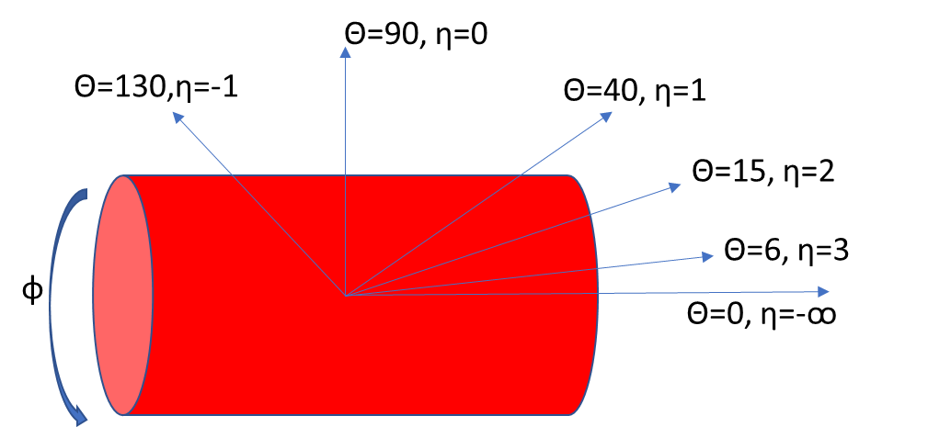
LHC ATLAS detector
T T-bar produced once every second
HCLAL, ECAL and Tracker
Coordinate systems

Slide 5
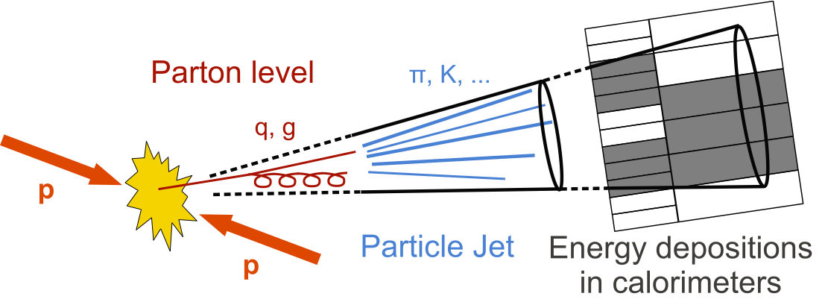
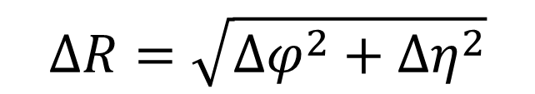
What's a jet ?
size parameter R
Infrared and collinear safe
Anti kt algorithm
$$∆R=\sqrt{{∆φ}^{2}+{∆η}^{2}}$$

Slide 6
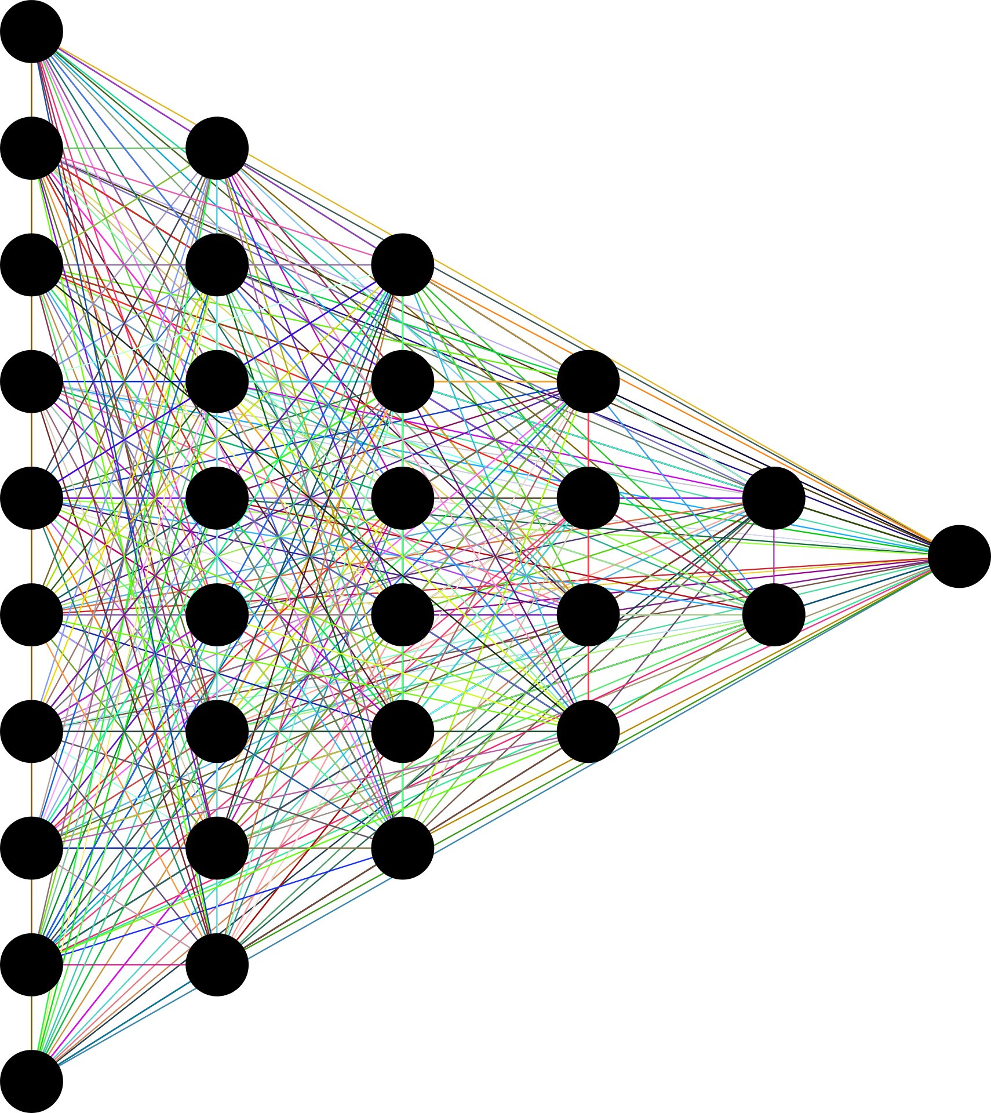
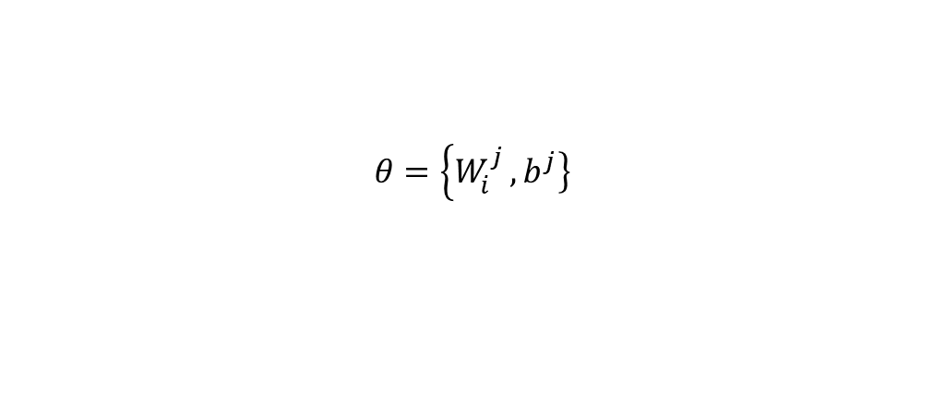
Theory Machine Learning
Multiple layers
Activation
loss function
optimization
$$θ=\left\{W_{i}^{j}\right.,\left.b^{j}\right\}$$

Slide 7
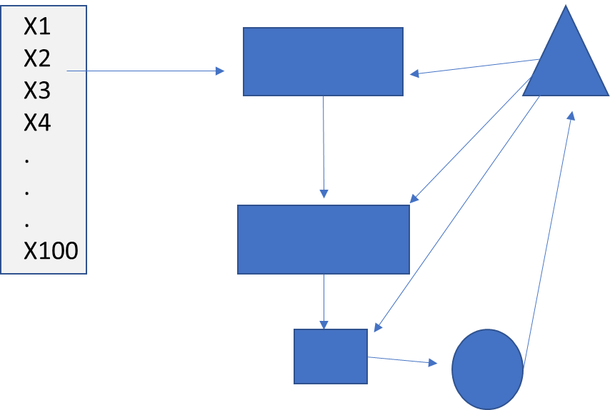
Theory machine Learning Flow chart

Slide 8
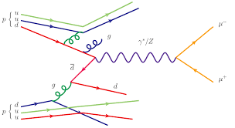
Procedure -Simulating Data
Mad Graph + pythia8
-cross section simulations at Leading order
-15k ttbar +15k QCD background events simulated
Delphes + FastJET
-Detector simulations
-jet algorithm anti-kT with R=0.8
-Energy flow particles

Slide 9
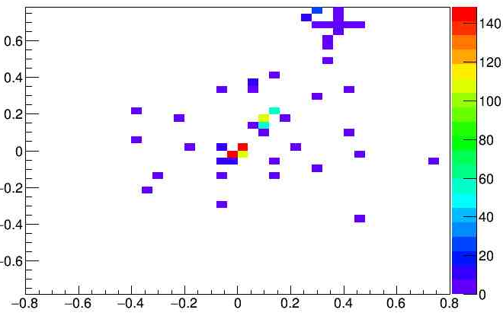

Procedure –Jet Selection in ROOT
jet pT 550-650 GeV with $\left|η\right|<2$,
W boson and B quark decayed within R<0.8 of jet axis
Kept first 200 constituents of each jet, recorded their 4 vector information , padded with zero vectors,
Jets were translated highest pT constituent at (0,0), and rotated in y-z plane
φ
η

Slide 10

Neural Network with TensorFlow
300
12
6
Trained on20k jets tested with 4k
Batch sizes 5000
40 epochs
Binary cross Entropy Loss function
Adam Optimizer
Output: Accuracy and Loss
102
1
Activation function: Sigmoid
Activation function: Rectified Linear Unit

Slide 11

Results
Accuracy during training reached 92% after 40 epochs
Accuracy during testing reached 78%
Background rejection rate was as high as 80% depending on the trial
Loss was similar no matter the trial $\sim$0.6

Slide 12
Results from previous studies+disucssion
93% accuracy
Order of particles…

Slide 13
Disucssion
order

Slide 14
Refrences
All programs
Archive papers

Slide 15
Procedure -preprocessing
Reorderd
Translation in eta and phi
Rotation in y-z plane similar a rotation in eta phi

